Slide 1
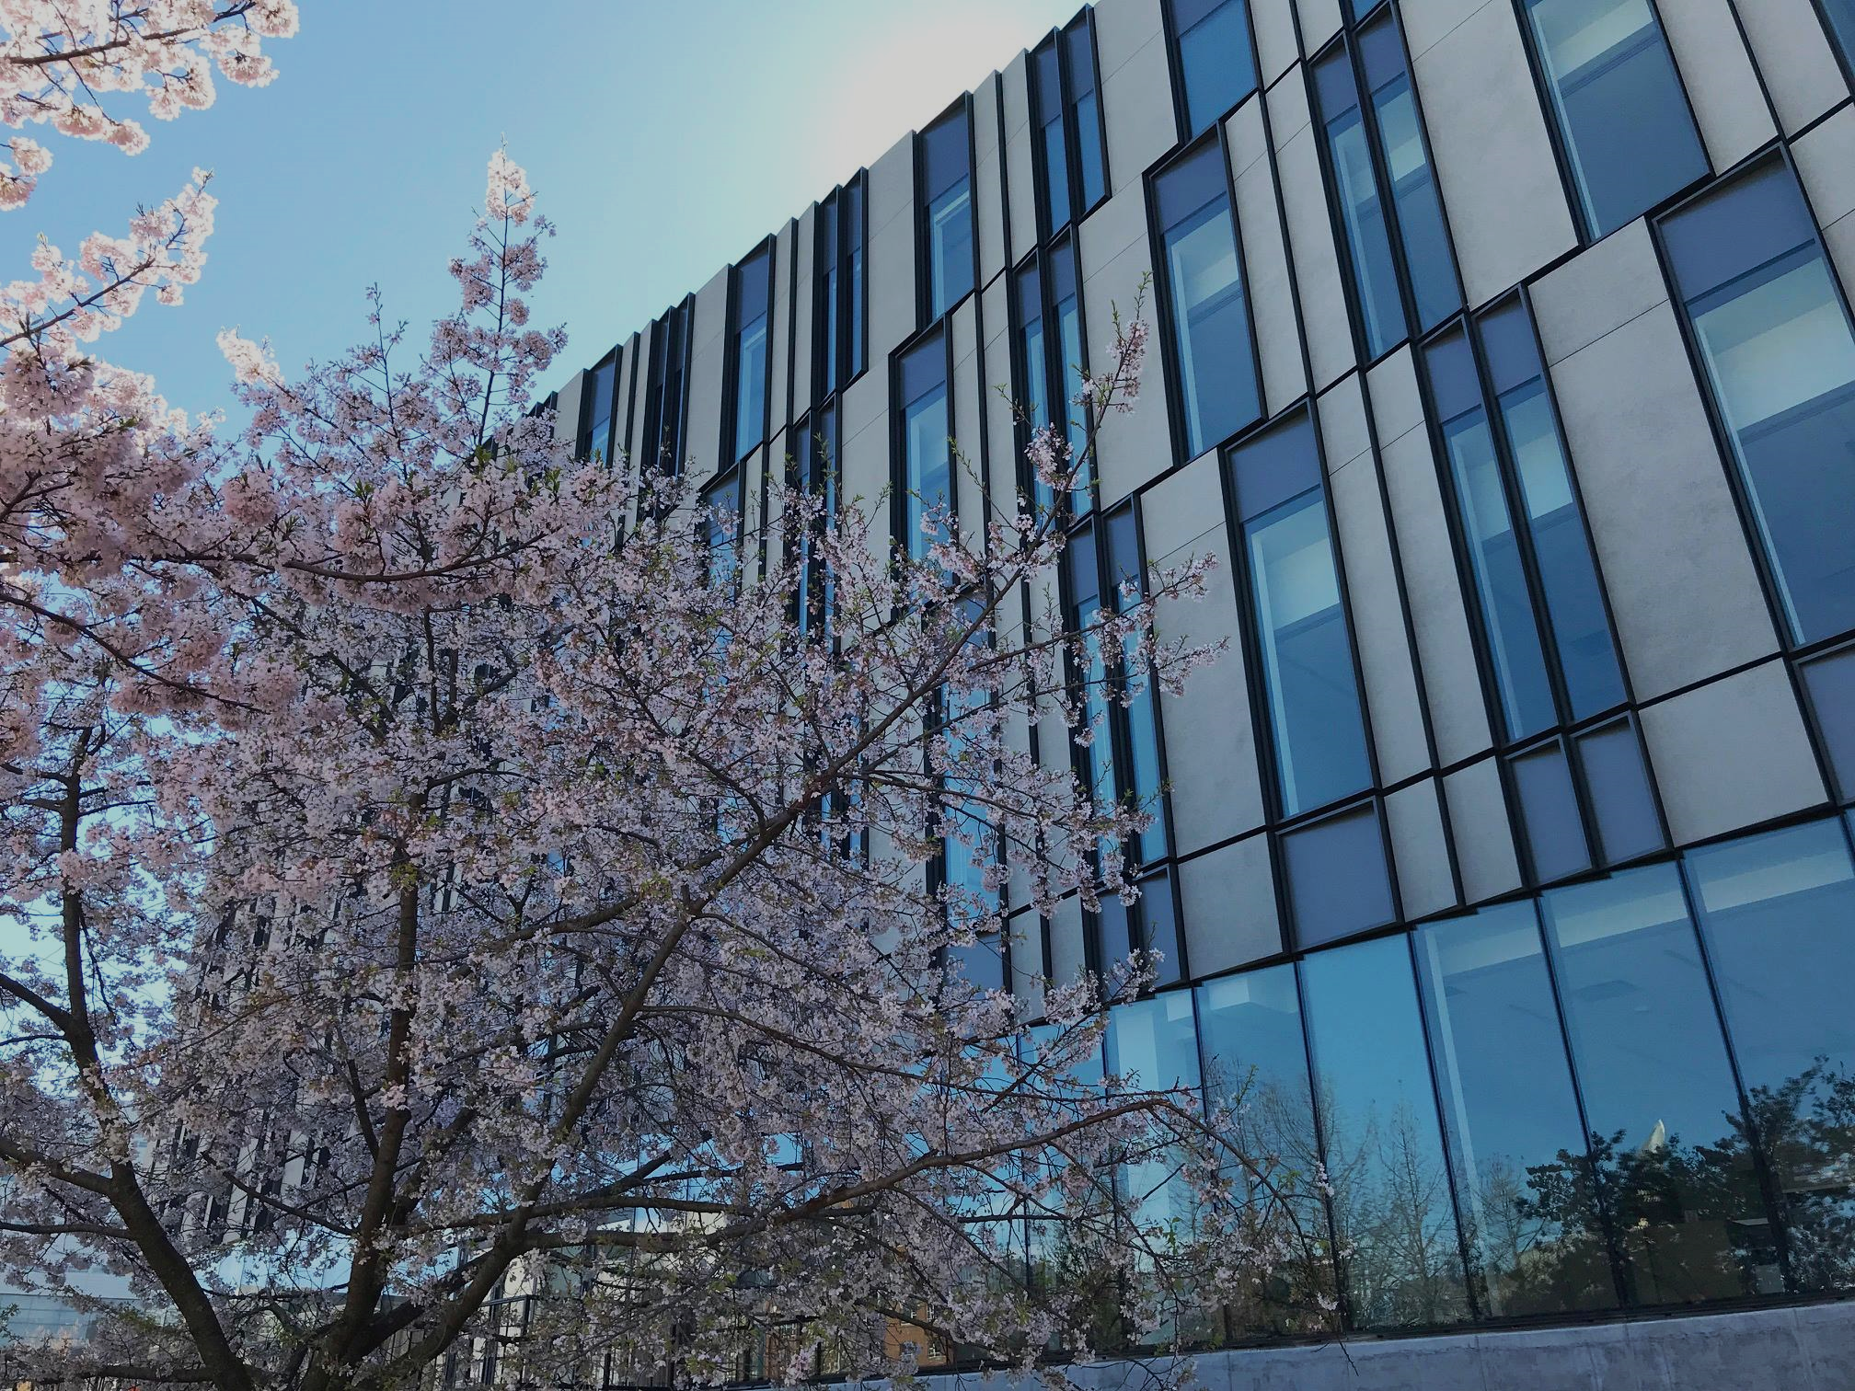
Sigma Consulting
Building Your World
https://www.facebook.com/LindnerCollege/

Slide 2
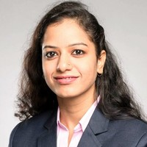
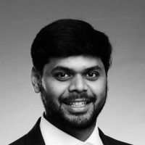

Team Members
CEO
CTO
CMO, CFO
Radhika Sood
Aman Rastogi
Umesh Singh

Slide 3
Our Expertise
100+ Clients
500+ Cases
24 cities across the US
$18 mn revenues

Slide 4









Our Successful Clients

Slide 5
Case: Online Bookstore
1Comprehensive Book Catalog
2 Market Penetration
3 Product Development

Slide 6
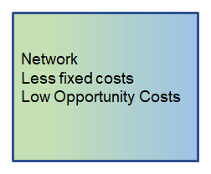
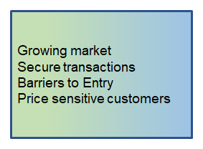
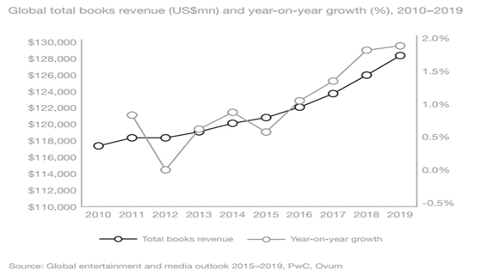


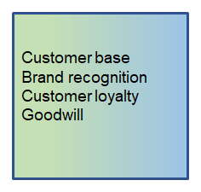
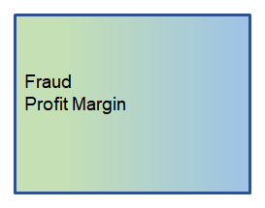


SWOT ANALYSIS

Slide 7
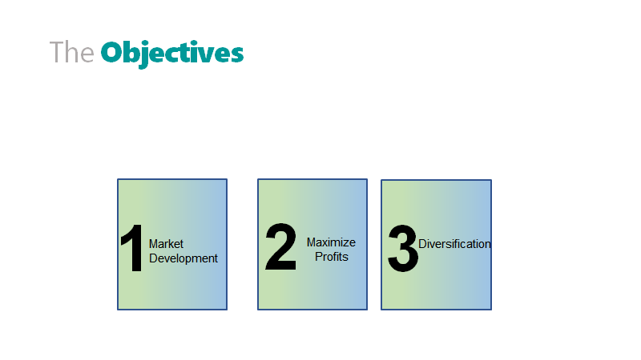

Slide 8

Target Markets

Slide 9


Slide 10
Business Use Case

Slide 11
Overall Business Process

Slide 12
Customer Process

Slide 13
Bookstore Business Process

Slide 14
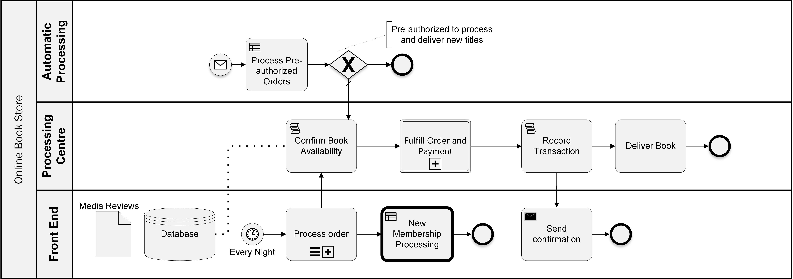
Bookstore Business Process

Slide 15
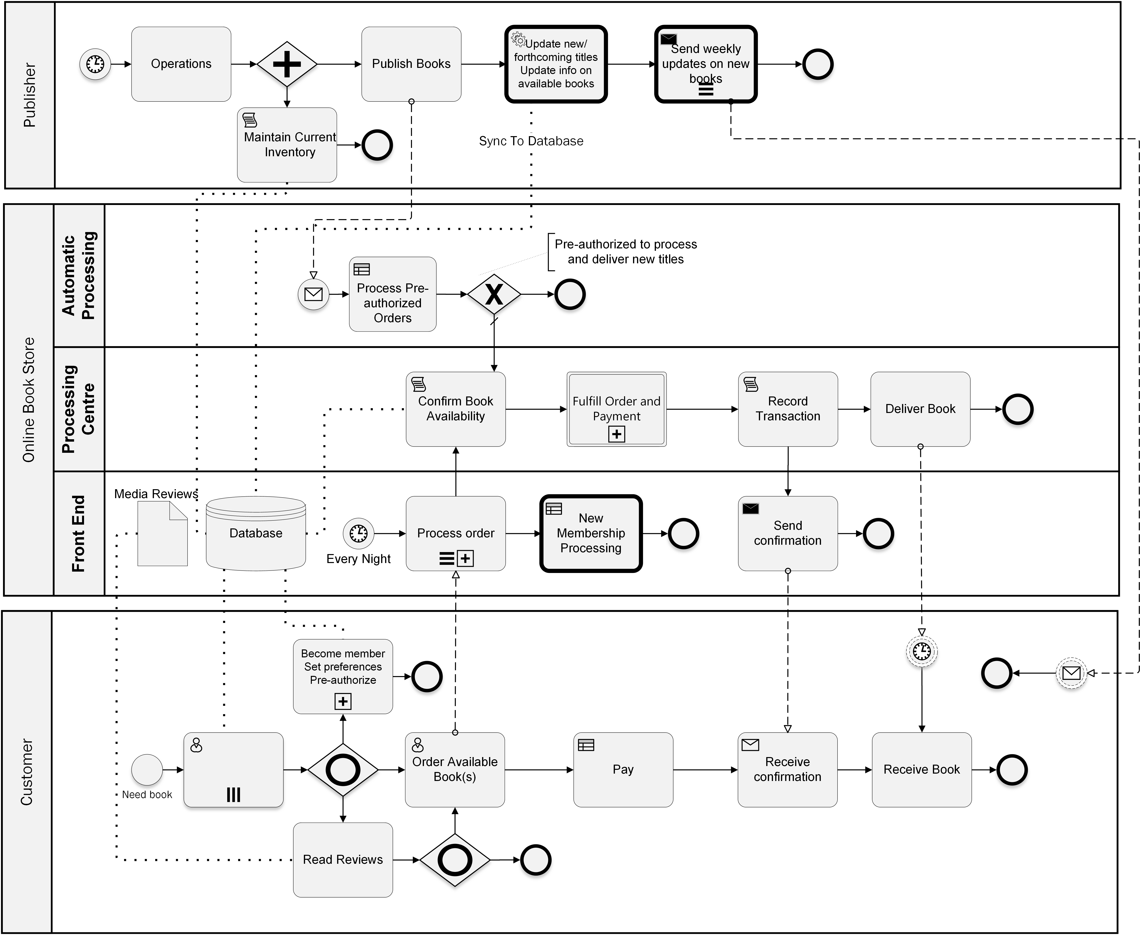
Publisher Process

Slide 16
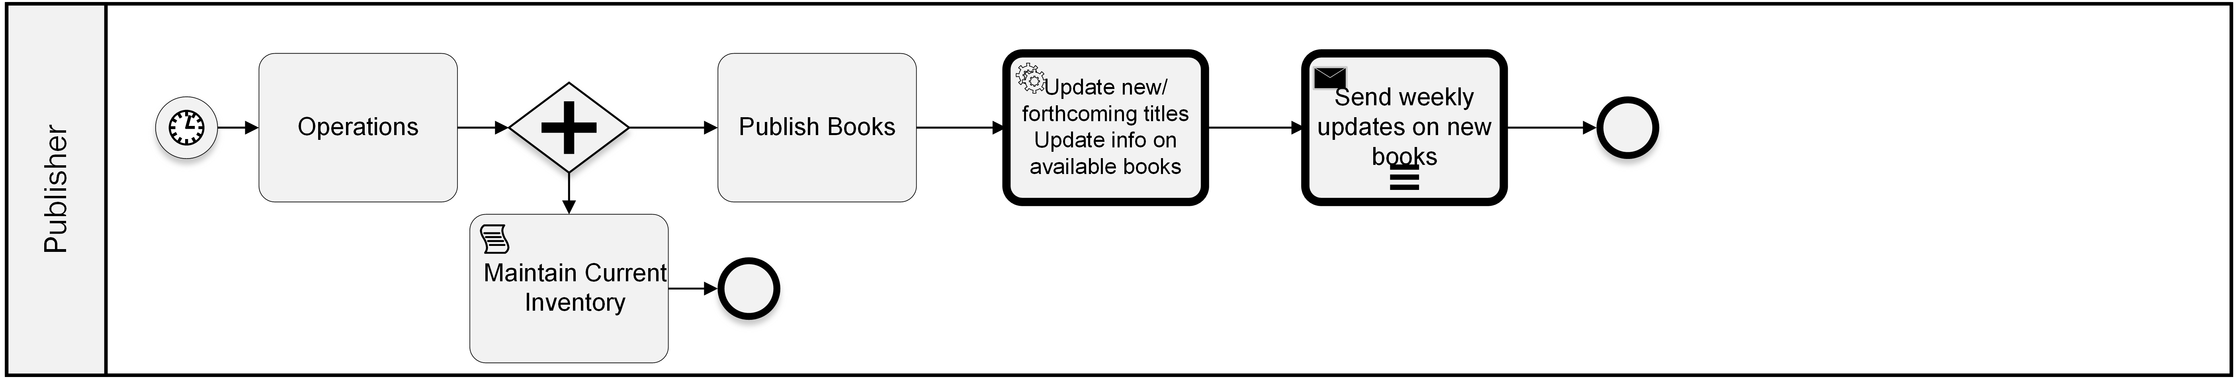
Publisher Process

Slide 17


Slide 18
Estimation of Software Size Use-Case Points
Unadjusted Actor Weight Total (UAW) = 15 + 2 = 17
Unadjusted Use Case Weight (UUCW) = 30
Unadjusted Use-Case Points (UUCP) = UAW + UUCW = 17 +30 = 47
Actor type | Description | Weighing Factor | Number | Result
Simple | Ext. system with well-defined API | 1 | 0 | 0
Average | Ext. system with a protocol-based interface | 2 | 1 | 2
Complex | Human | 3 | 5 | 15
UC Type | Description | Weighing Factor | Number | Result
Simple | 1- 3 transaction | 5 | 6 | 30
Average | 4-7 | 10 | 0 | 0
Complex | >7 | 15 | 0 | 0
Notes:
We determined the UCP to forecast the software size for software development

Slide 19
Environmental Factors & Final Estimate
Tech Complexity Factor = 1.4 + (.03*Efactor) = 1.4 + (0.03*25.5)
Adj. UCP = UUCP * TCF * ECF = 47 × 0.750 × 0.635 = 22.38
Effort in person-hours = UCP × PHM = 20 × 22.38 = 428.65 hours (11 weeks @40 hr/week)
Factor # | Description | Weight | Assigned Value | Weighted Value
E1 | Familiarity with system development | 1.5 | 4 | 6
E2 | Application Experience | .5 | 4 | 2
E3 | Object Oriented experience | 1 | 4 | 4
E4 | Lead Analyst Capability | .5 | 5 | 2.5
E5 | Motivation | 1 | 5 | 5
E6 | Requirement Stability | 2 | 5 | 10
E7 | Part time Staff | -1 | 0 | 0
E8 | Difficulty of Programming Language | -1 | 4 | -4
Notes:
Environmental Factor = 1.4 + (.03* EFactor)

Slide 20
Total Maintenance Cost (Fixed and Variable)
Itemized Description | Cost
Full-stack developers | $70,000/year
Marketing through Google Ads | $2000/year
Cost of Server Maintenance | $2000/year
Logistics | 10000/year
Fixed Cost | 12000/year
Total | 96000/year

Slide 21
Strategy and Milestones
Market Penetration
Product Dev
Market Dev
Diversification
Notes:
Marketing mix to help understand what the product or services can offer and how to plan for a successful product offering
Initial strategy will be market penetration; will target price sensitive customers such as young college-goers
Initially system will be developed to process daily orders sequentially only once a day.
With improvements in software development, maintenance and security, a real-time order processing will be implemented;
We will invest in market research to develop and validate a price matching algorithm so that we will be able provide our customers the lowest price they are willing to pay

Slide 22
Strategy and Milestones
Market Penetration
Product Dev
Market Dev
Diversification
Notes:
Moving forward in the next two years we will target on market development through collaboration with new publishers and academia;
Thourhg improved logistics resulting in faster delivery. This will increase customer base and customer loyalty and goodwill

Slide 23
Strategy and Milestones
Market Penetration
Product Dev
Market Dev
Diversification
Notes:
Eventually we envision diversification through product development and market expansion
We aim to sell ebooks in formats that have cross-platform interoperability

Slide 24
Why Sigma Consulting?
Intellect
effectively communicate
strategy for success
prominent brand identity
Notes:
we have the intellect to think through and effectively communicate the strategy for success
translate strategy into a prominent brand identity

Slide 25
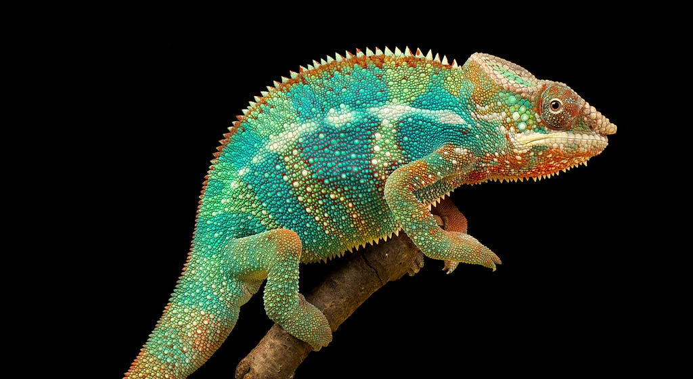
Why Sigma Consulting?
We Perpetually Adapt
To Meet Market Demands
As a customer service chameleon, our greatest asset is our adaptability
Notes:
As a customer service chameleon, adaptability is our best assest; we are constantly adapting to meet the market demands and beat the market forces.
It gives the clients a real understanding of what value we bring to the table, and if it aligns with their objectives
if they prioritize good work, exceptional service, new ideas, and a long-term relationship, then we're the team for you

Slide 26

Thank You!

Slide 27
Anticipated Problem
Determination of breakeven point
Weaknesses for any start-up
No Customer Base/Customer Loyalty
No Goodwill
No Brand Recognition
Must keep minimum margin to survive against competitors
Although fixed cost are estimable, determination of margin is difficult and is uncertain. Unless there is distinct competitive advantage, determination of breakeven point is difficult.

